Slide 1

Space Patrol
Developed by: Roberto Ito & Yayun Yang

Slide 2
Roles
Roberto Ito
Designer
Developer
QA Tester
Yayun Yang
Designer
Developer
QA Tester

Slide 3
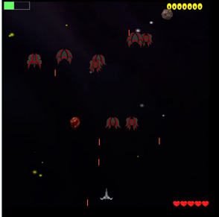
Game Interface

Slide 4
Overview
Top down shooter game with space background
Difference weapon types, enemies, obstacles, and collectibles

Slide 5
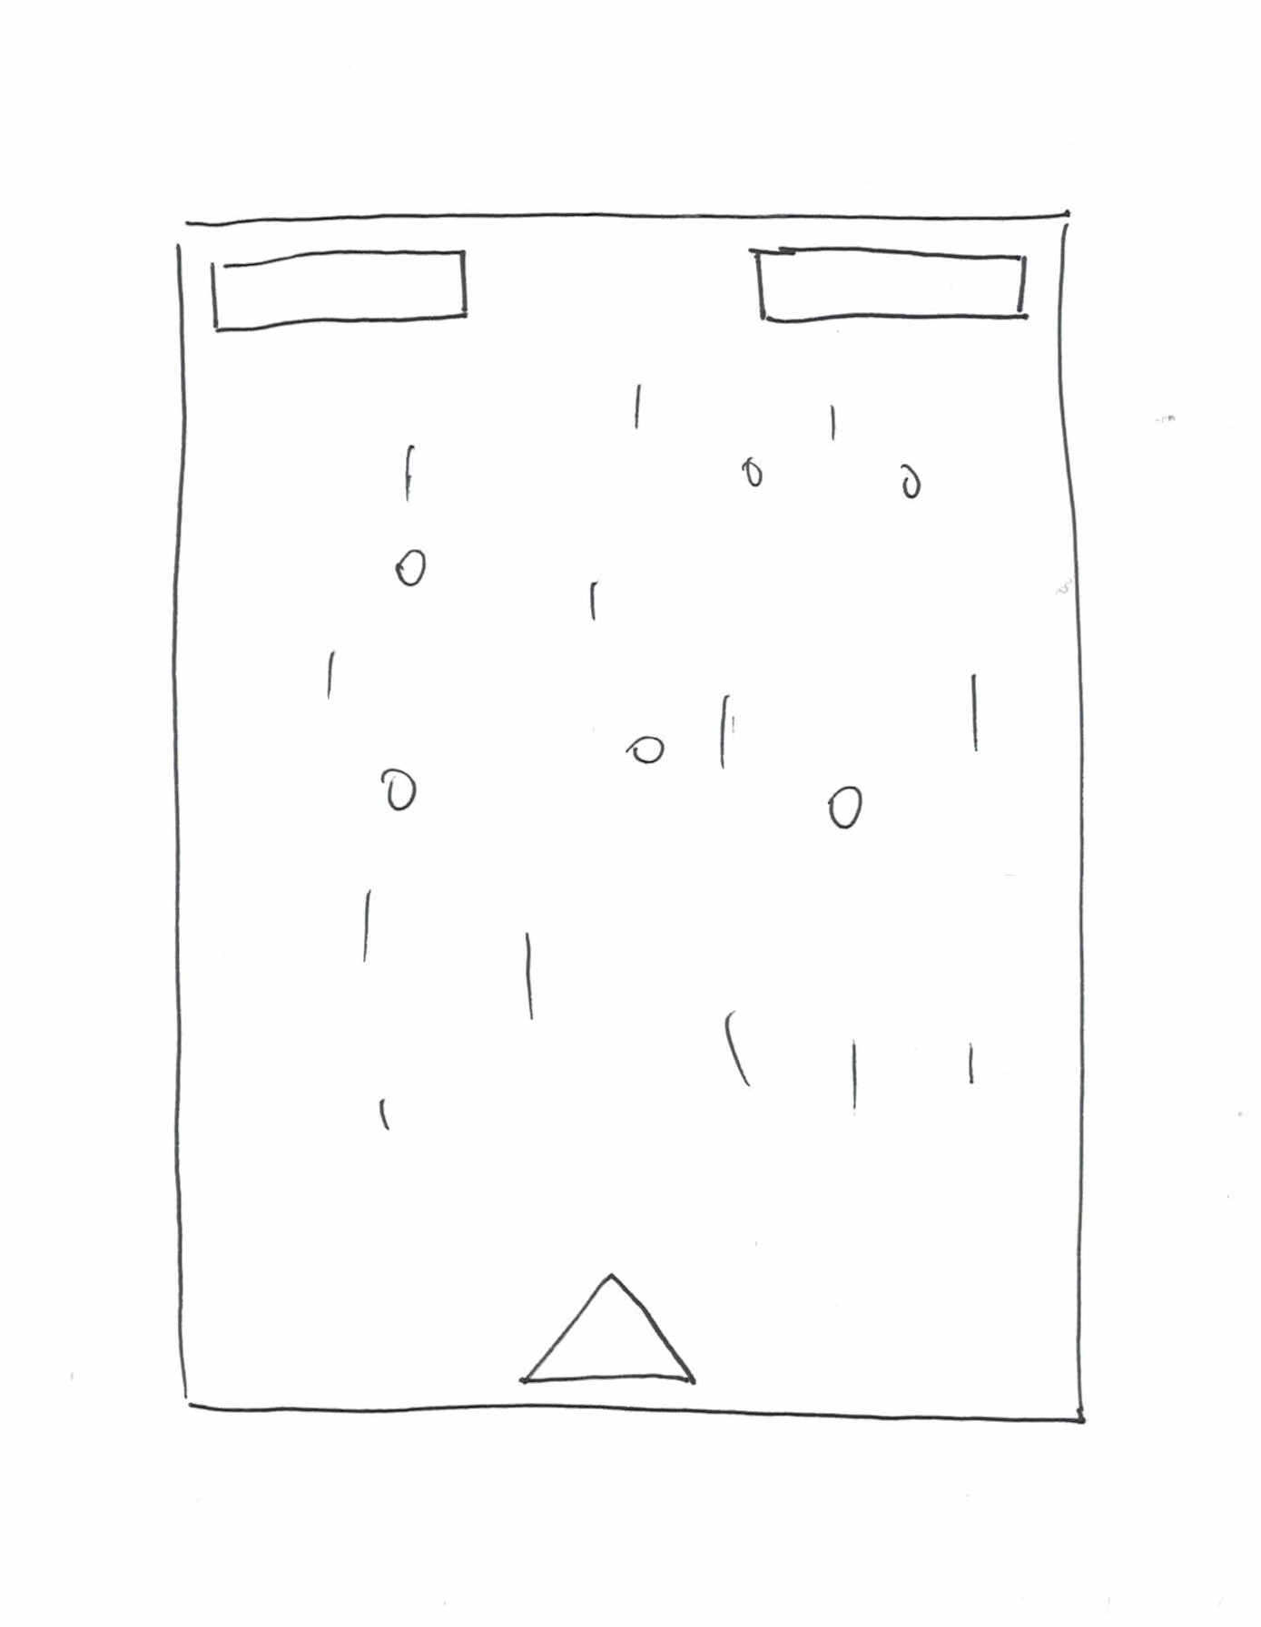
Planning

Slide 6
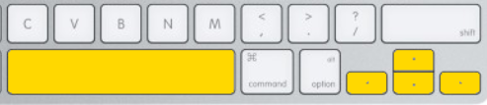
Instruction
Controls of our game
Scoring
4 types of enemies - 10, 20, 30, 40
2 types of meteors - 5, 10
3 bosses - 1000, 2000, 3000

Slide 7
Lessons Learned
CreateJS
State designing
Movement designing

Slide 8
Future Possibilities
Weapon extension
Cheat code

Slide 9
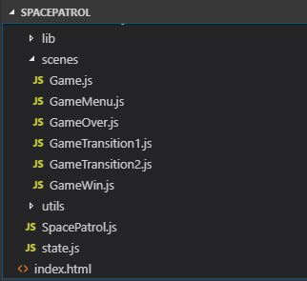
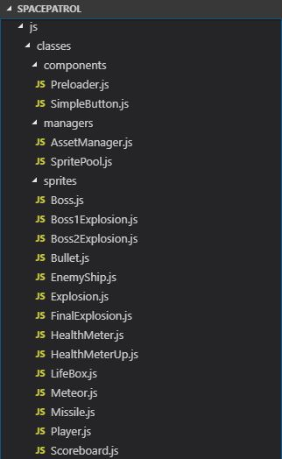
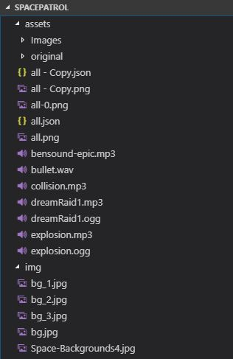
Code structure and organization

Slide 10
State Diagram

Slide 11
Class Diagram

Slide 12
Classes

Slide 13
Game link
https://robertoito.github.io/SP_FB/

